Slide 1
Updates from the WMO/GAW Programme
Lorenzo Labrador
WMO Science and Innovation Department

Slide 2
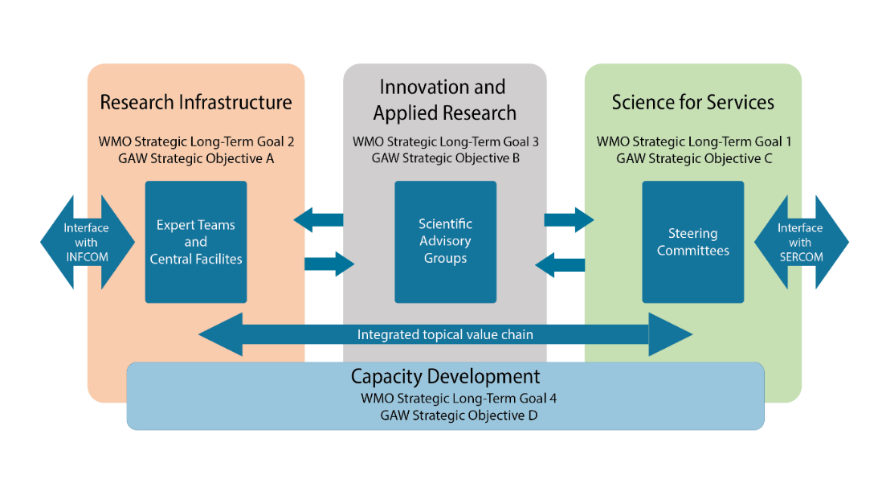
Internal organization of GAW/ alignment with WMO Strategic Objectives
GAW Programme activities follow GAW Implementation Plan 2016-2023 until December 2023.
2024-2027 Science and Implementation Plan (SIP) to be approved by WMO Congress in late May, goes into effect in January 2024
GAW Bodies (i.e. (SAGs, ETs, science-for-services Initiatives) currently aligning activities with new SIP and producing workplans for 2024-2027
Notes:
WMO Strategic goals:
Better serve societal needs: Delivering, authoritative, accessible, user-oriented and fit-for-purpose information and services; SERVICES
2. Enhance Earth system observations and predictions: Strengthening the technical foundation for the future; INFRASTRUCTURE 3. Advance targeted research: Leveraging leadership in science to improve understanding of the Earth system for enhanced services RESEARCH 4. Close the capacity gap on weather, climate, hydrological and related environmental services: Enhancing service delivery capacity of developing countries to ensure availability of essential information and services needed by governments, economic sectors and citizens; CAPACITY BUILDING 5. Strategic realignment of WMO structure and programmes for effective policy- and decision-making and implementation; POLICY
GAW Strategic Goals:
Strengthen the atmospheric composition and flux measurement and data infrastructure and contribute to understanding trends, variability and extremes - INFRASTRUCTURE
Improve monitoring and predictive capabilities through applied research aimed at advancing understanding of the roles and fate of aerosols, reactive gases, stratospheric ozone, and greenhouse gases and their interactions in the Earth System - RESEARCH
Advance the application of atmospheric composition information in support of policies and conventions, and expand societal services related to air quality, human and ecosystem health, climate change and food production – SERVICES
Enhance capacity throughout the GAW Programme and promote the use of atmospheric composition information – Capacity Development

Slide 3
WMO – GAW, alignment of strategic objectives
WMO Strategic goals:
Better serve societal needs: Delivering, authoritative, accessible, user-oriented and fit-for-purpose information and services - SERVICES
2. Enhance Earth system observations and predictions: Strengthening the technical foundation for the future - INFRASTRUCTURE 3. Advance targeted research: Leveraging leadership in science to improve understanding of the Earth system for enhanced services - RESEARCH 4. Close the capacity gap on weather, climate, hydrological and related environmental services: Enhancing service delivery capacity of developing countries to ensure availability of essential information and services needed by governments, economic sectors and citizens - CAPACITY DEVELOPMENT 5. Strategic realignment of WMO structure and programmes for effective policy- and decision-making and implementation – POLICY
GAW Strategic Goals:
Strengthen the atmospheric composition and flux measurement and data infrastructure and contribute to understanding trends, variability and extremes - INFRASTRUCTURE
Improve monitoring and predictive capabilities through applied research aimed at advancing understanding of the roles and fate of aerosols, reactive gases, stratospheric ozone, and greenhouse gases and their interactions in the Earth System - RESEARCH
Advance the application of atmospheric composition information in support of policies and conventions, and expand societal services related to air quality, human and ecosystem health, climate change and food production – SERVICES
Enhance capacity throughout the GAW Programme and promote the use of atmospheric composition information – Capacity Development
Notes:
WMO Strategic goals:
Better serve societal needs: Delivering, authoritative, accessible, user-oriented and fit-for-purpose information and services; SERVICES
2. Enhance Earth system observations and predictions: Strengthening the technical foundation for the future; INFRASTRUCTURE 3. Advance targeted research: Leveraging leadership in science to improve understanding of the Earth system for enhanced services RESEARCH 4. Close the capacity gap on weather, climate, hydrological and related environmental services: Enhancing service delivery capacity of developing countries to ensure availability of essential information and services needed by governments, economic sectors and citizens; CAPACITY BUILDING 5. Strategic realignment of WMO structure and programmes for effective policy- and decision-making and implementation; POLICY
GAW Strategic Goals:
Strengthen the atmospheric composition and flux measurement and data infrastructure and contribute to understanding trends, variability and extremes - INFRASTRUCTURE
Improve monitoring and predictive capabilities through applied research aimed at advancing understanding of the roles and fate of aerosols, reactive gases, stratospheric ozone, and greenhouse gases and their interactions in the Earth System - RESEARCH
Advance the application of atmospheric composition information in support of policies and conventions, and expand societal services related to air quality, human and ecosystem health, climate change and food production – SERVICES
Enhance capacity throughout the GAW Programme and promote the use of atmospheric composition information – Capacity Development

Slide 4
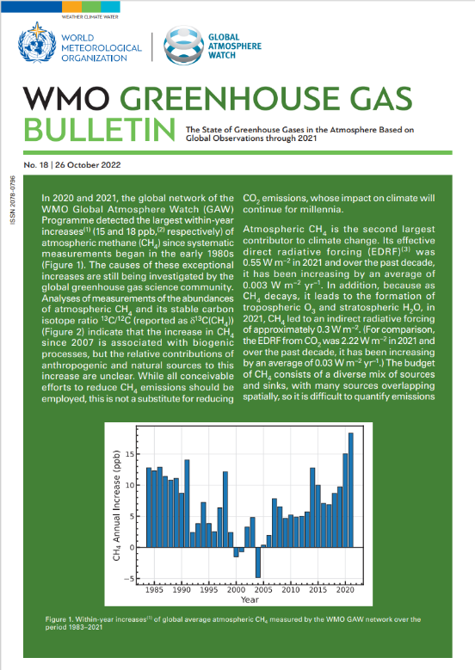
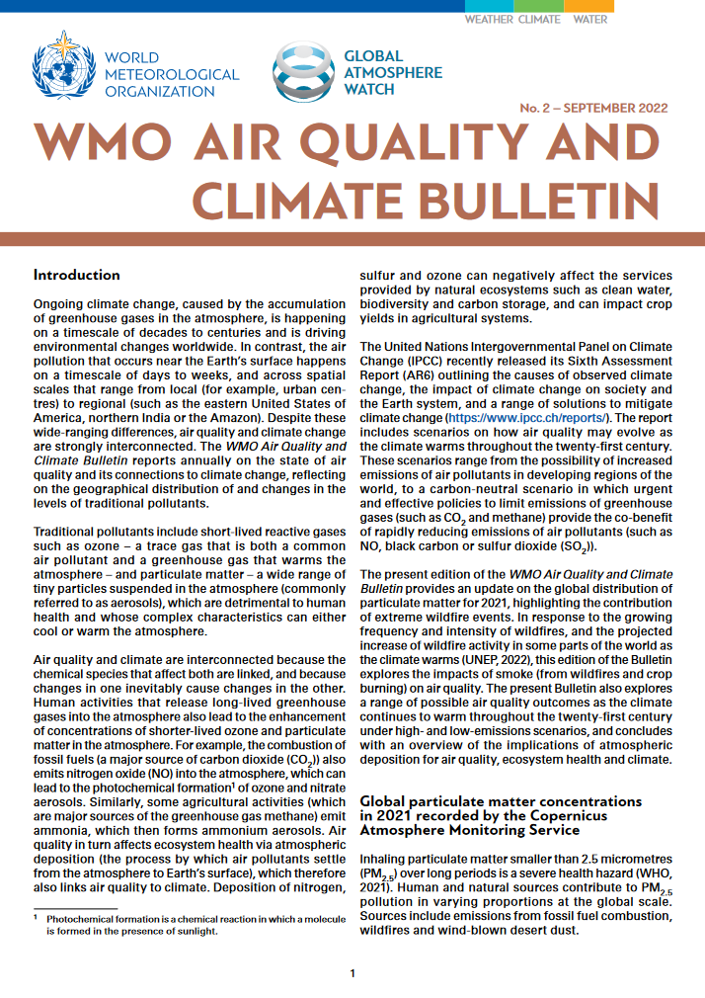
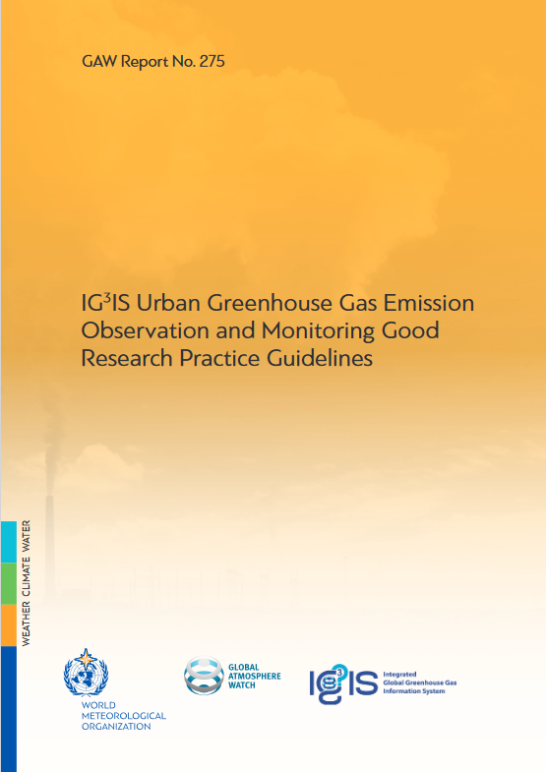
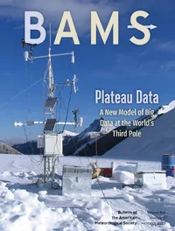
Update: Support of environmental and climate policy
18th 2022 GHG Bulletin – October 2022
WMO/IAEA Meeting on Carbon Dioxide, Other Greenhouse Gases and Related Measurement Techniques (GGMT-2022) - Recommendations on GHG measurements - Oct 2022)
IG³IS: urban GHG measurements good practices document, GAW Report 275, 2022
2022 Scientific Assessment of Ozone Depletion
IG³Is works on national guidelines
GESAMP’s Working Group 38 workshop on the potential role of atmospheric deposition in driving ocean productivity in the Southwest Indian Ocean
The IG³IS Stakeholder consultations and User Summit – Feb. 2023
2023 BAMS article on the value of Global Atmospheric Composition
Observations
WMO Greenhouse Gas Monitoring Infrastructure (GGMI)
IG³IS and SAG on GHG supporting GGMI
Notes:
IG³IS is an observation-based information system for determining trends and distributions of greenhouse gases (GHGs) in the atmosphere and the ways in which they are consistent or not with efforts to reduce GHG emissions.
Ozone assessment - Actions taken under the Montreal Protocol continued to decrease atmospheric abundances of controlled ozone-depleting substanc- es (ODSs) and advance the recovery of the stratospheric ozone layer.
The recent identification of unexpected CFC-11 emissions led to scientific investigations and policy responses.
GESAMP WG38 Workshop: The workshop will include international and local scientists, managers, and policymak-ers, and it will evaluate the atmospheric inputs and impacts of nutrients from biomass burning and industrial emissions to the Madagascar Channel and the southwest Indian Ocean
The IG³IS Stakeholder consultations and User Summit event brought together key users from several sectors to engage in conversation with the IG³IS scientific community. WMO is inviting stakeholders and users to articulate their needs for data-driven GHG emission information at multiple scales (e.g., national, urban, facility).

Slide 5
GGMI: WMO Executive Council 75, June 2022:
Decided to form a joint Study Group between INFCOM, SERCOM and the Research Board, with appropriate involvement of external stakeholders, to undertake the following tasks:
(1) To develop the concept, including identifying the future vision for WMO-coordinated GHG-related activities, its outputs and expected contributions from and benefits for Members, leveraging synergies with existing frameworks such as the Global Atmosphere Watch (GAW) and the Integrated Global Greenhouse Gas Information System (IG³IS);
(2) To submit a final proposal of the concept for its architecture with identified key gaps between Members’ operational needs and existing relevant WMO activities to the 19th World Meteorological Congress in 2023;

Slide 6
GHG Monitoring Infrastructure: elements
In its initial configuration, the GGMI would consist of four main components:
(1) A comprehensive sustained, global set of surface-based and satellite-based observations, with an associated data management system of CO₂, CH₄ and N₂O concentrations, total column amounts, partial column amounts, vertical profiles, fluxes and supporting meteorological, oceanic, and terrestrial variables. These observations should be internationally exchanged as rapidly as possible, pending capabilities and agreements with the system operators;
(2) Prior estimates of the GHG emissions based on activity data and process-based models;
(3) A set of global high-resolution Earth System models representing GHG cycles;
(4) Data assimilation systems, associated with the models in component 3, that optimally combine the observations (component 1) and prior estimates (component 2) with model calculations to generate optimal estimates of concentrations and fluxes.

Slide 7
GHG Monitoring Infrastructure: outputs
• Monthly CO₂ net fluxes between the Earth surface and the atmosphere with 1x1 degree horizontal resolution delivered with a maximum delay of one month
• Monthly CH₄ net fluxes between the Earth surface and the atmosphere with 1x1 degree horizontal resolution delivered with a maximum delay of one month
• 3D fields of atmospheric CO₂ and CH₄ abundance with hourly resolution and the latency to be defined through user requirements and further consultation (tentatively on the order of a few days).
• N₂O abundances and net fluxes with resolution and latency still to be defined.

Slide 8
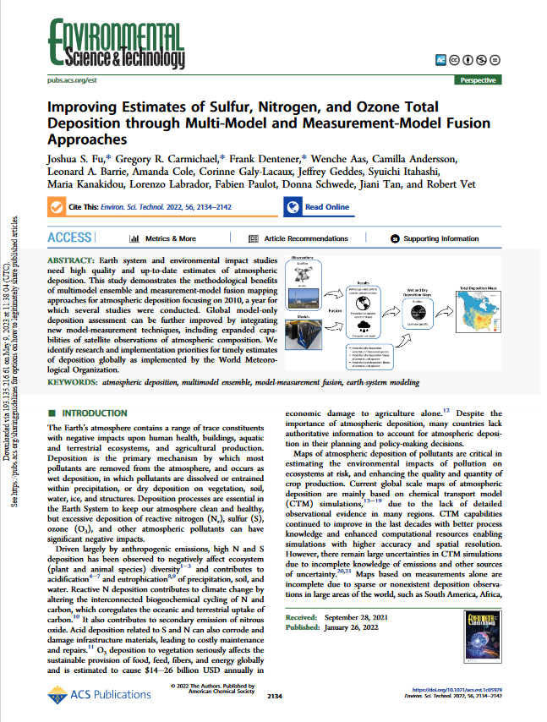
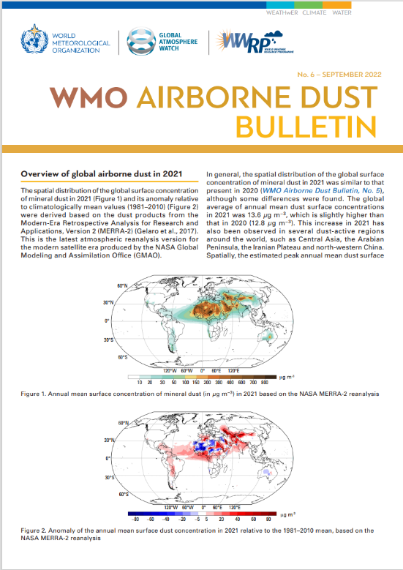
Updates: Support of the health/ecosystems sector
2022 Air Quality and Climate Bulletin: effects of atmospheric deposition on critical loads for ecosystems (among others) - September
2023 Sand and Dust Bulletin in preparation – September 2023
Measurement-Model Fusion for Global Atmospheric Deposition Initiative
The AiR Pollution, Climate Change, Health Effects (ARCH) Working Group identifies, and addresses knowledge gaps related to air quality and COVID-19 through international collaboration.
Notes:
MMF brings together best-available data and modelling results on precipitation chemistry, precipitation depth, air concentrations and dry deposition velocities to estimate wet, dry and total deposition. Also stakeholder engagement and funraising efforts
Organized online science workshop in September 2022 followed by MMF techniques workshop in October 2022 to follow up on the community paper (published in Jan 2022)
NILU collected the dataset for the development of the first prototype product for 2010. Further data-gathering activities are ongoing

Slide 9
Update: Urban sector
Urban Workshop 13-15 June 2022
Brought together diverse groups working on the WMO urban agenda
Took stock of the existing activities
Developed recommendations for improved coordination on urban-related activities
Launch of 3 documents at the Urban Workshop
IG³IS Urban Greenhouse Gas Emission Observations and Modelling Good Practices - June
Guidance to Measuring, Modelling, and Monitoring the Canopy Layer Urban Heat Island (led by GURME) on 20 May
Good Practices on High-Resolution Modelling for Integrated Urban Services (by Study Group on Integrated Urban Services) on 24 May
2022 review of the WMO/GAW Low-cost sensor assessment report
Notes:
Ozone assessment - Conducted under the auspices of the WMO and UNEP, periodic "state-of-the-science" assessments have guided policymakers as they strengthened the original provisions of the Montreal Protocol.

Slide 10
Thank you for you attention.
Any questions?

